Slide 1
Problem
In today's fast paced consumer market, beginner entrepreneurs often struggle to sell their products due to lack of resources to build their own physical shop or unable to reach out their products to people in famous online websites due to presence of quite reputable brands. Also, the fast-fashion trend and products made from animal skin or synthetic commodities are also killing the environment making it concern for those people who value for sustainability.
Mission
To address both the challenges by creating an e-commerce platform where beginners who are willing to sell their eco-friendly products can easily reach out to public.

Slide 2

Our Solution

Slide 3
Target Audience
Sellers: Small-scale or new sellers of sustainable products, including those dealing in recycled plastics, eco-friendly handicrafts, etc.
Buyers: Environmentally-conscious consumers looking for sustainable and ethically sourced products.

Slide 4
Concept and Features
Concept Overview: A marketplace connecting small sellers of sustainable products with eco-conscious buyers.
Key Features:
Product Listings: Detailed listings for eco-friendly products, including images and descriptions.
Search and Filter Options: To find products by category (e.g., recycled plastics, handicrafts).
Community Forum: For anyone and everyone to interact, share tips, and discuss sustainability.

Slide 5
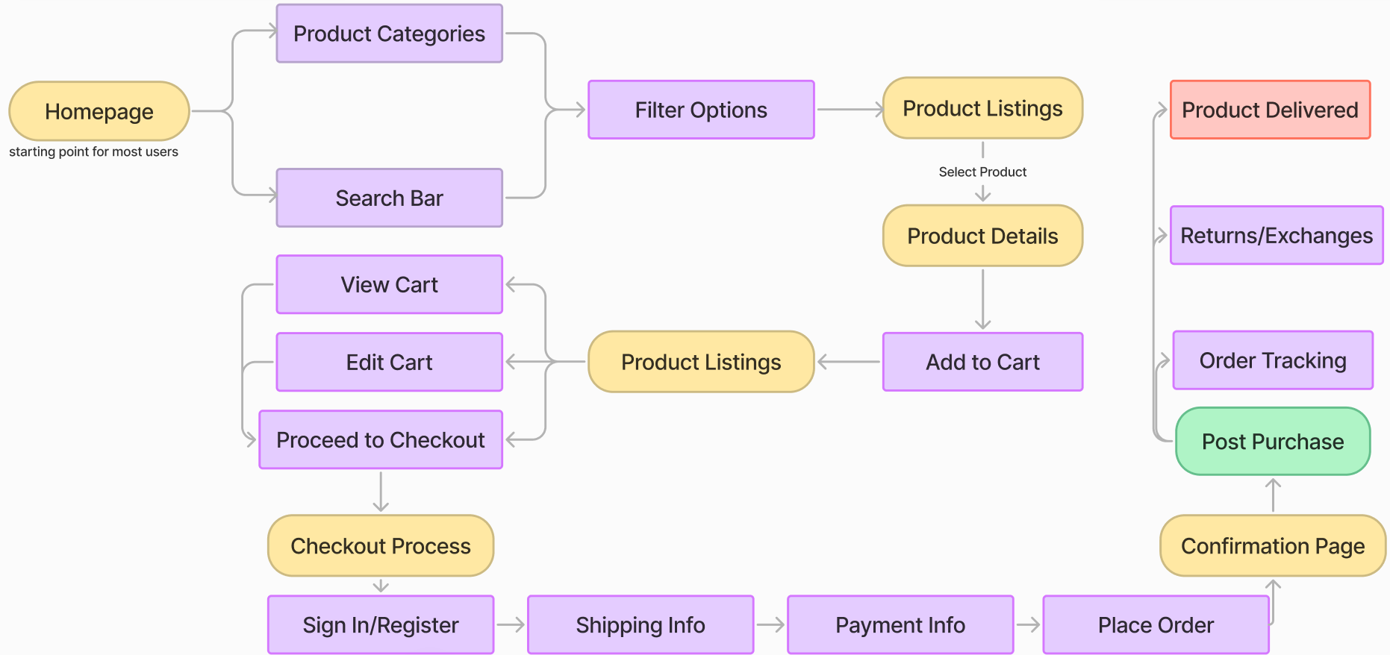
---Customer flow→

Slide 6
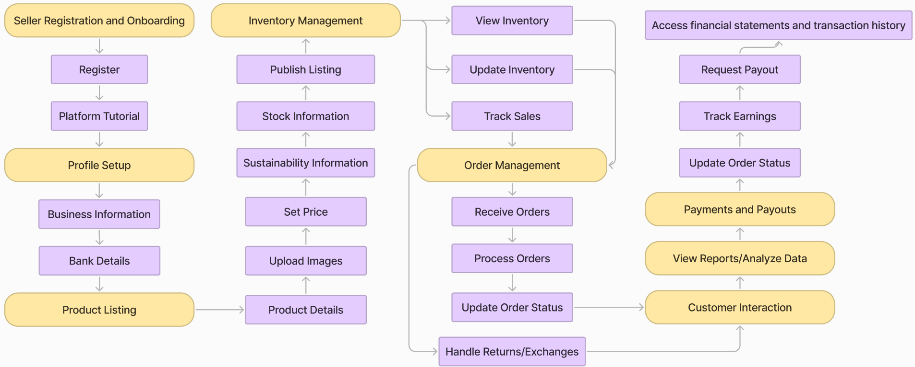
---Seller flow→

Slide 7
UI/UX Design and Aesthetics
Design Theme: Eco-friendly colors (greens, earth tones), clean and natural design.
Mockups:
Home Page: Clean layout with easy navigation and emphasis on eco-friendly products.
Product Listings: Attractive presentation of products with high-quality images.
Seller Profiles: Highlighting the story and impact of each seller.
UI/UX Principles: Focus on intuitive navigation, accessibility, and a seamless shopping experience

Slide 8
Technology Stack:
Frontend: React or Angular for a responsive and dynamic user interface.
Backend: Node.js with Django for server-side operations.
Database: MySQL or MongoDB for managing product and user data.
Payment Integration: PayTM or Gpay for secure transactions.

Slide 9
Summarizing Proposed Solution:
E-commerce platform that connects these sellers with buyers who prioritize sustainability.
Unique Features:
Seller Profiles: Allowing small and new sellers to create detailed profiles showcasing their eco-friendly products.
Sustainability Information.
Community Forum: Enabling interaction between buyers and sellers to foster a supportive eco-conscious community.
User-Friendly Interface: Easy navigation for both sellers and buyers, with features like advanced search, filters, and seamless checkout.

Slide 10
Thanks

